Slide 1
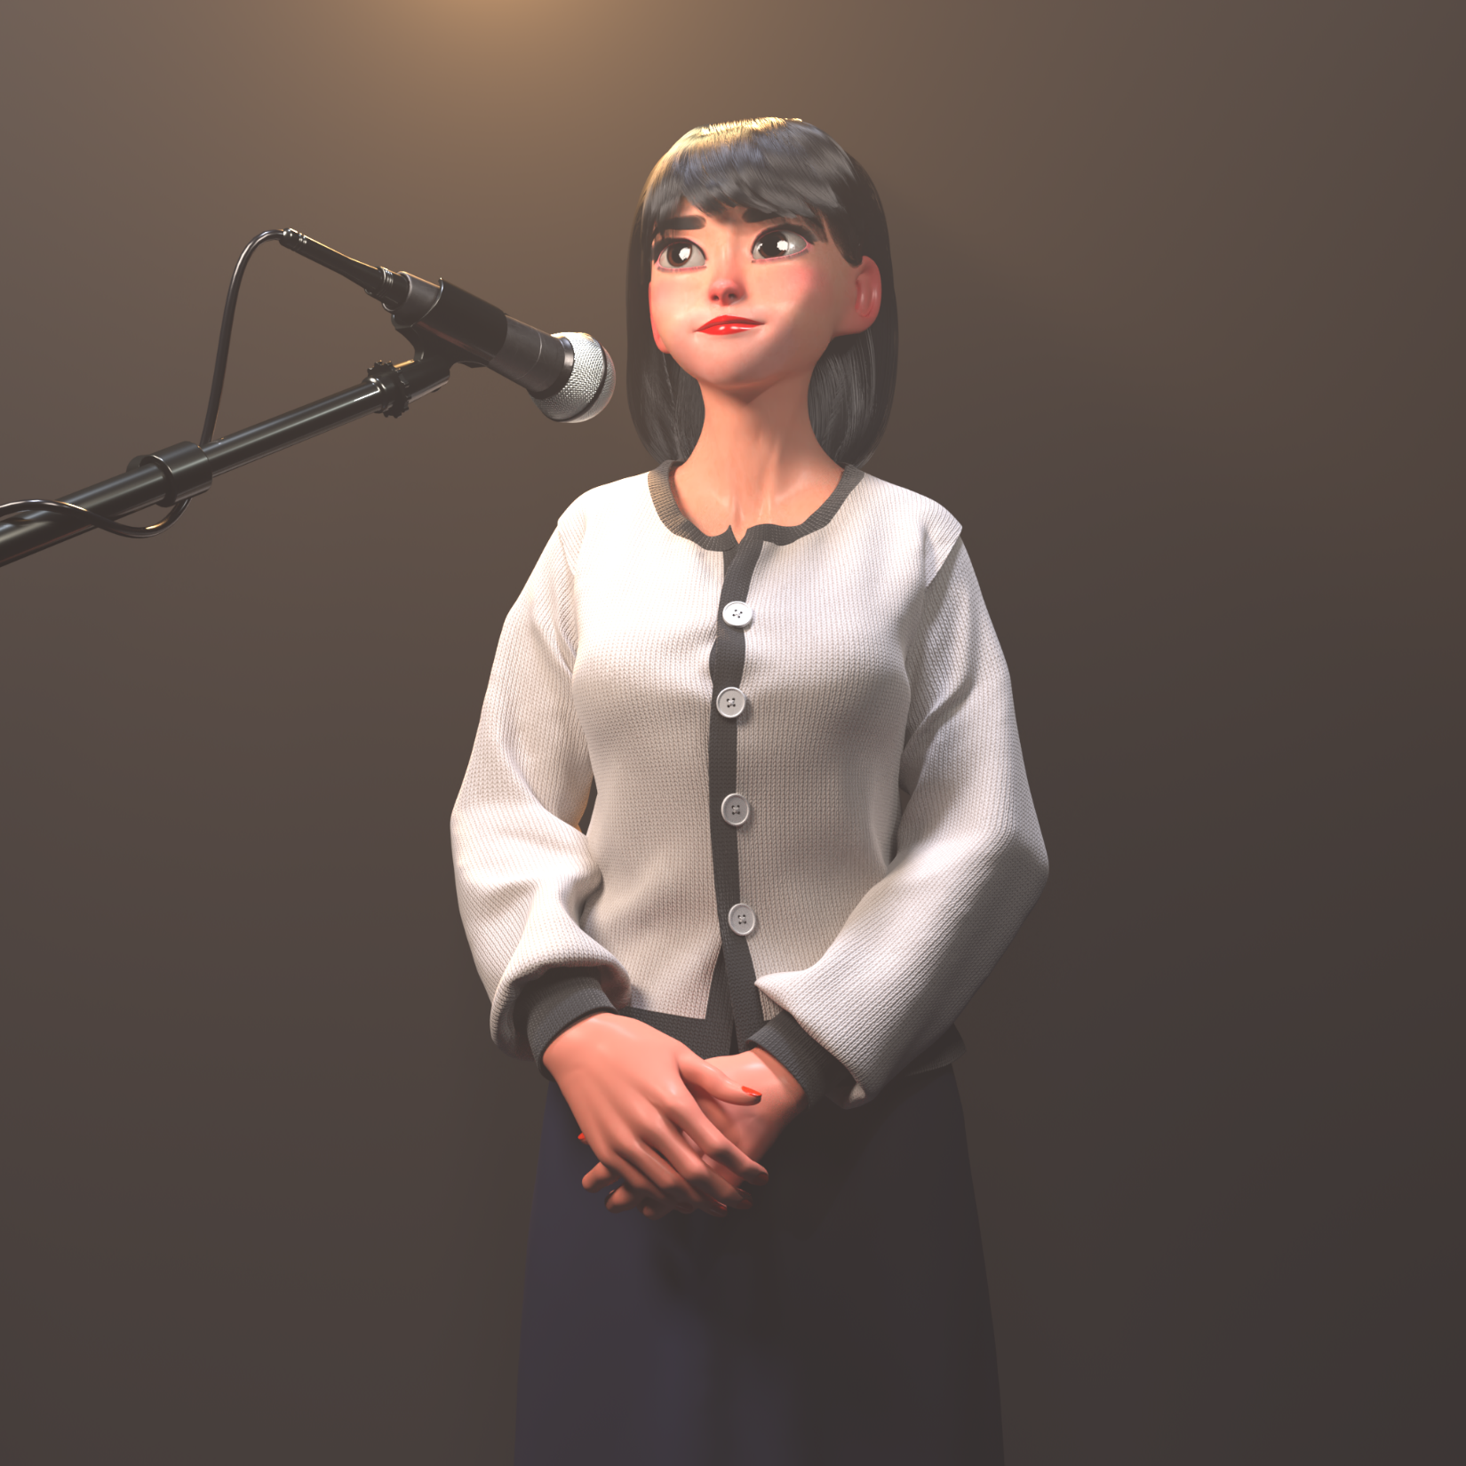
数字虚拟偶像实践 Based On Mediapipe & Jax
Bing
2022/08

Slide 2
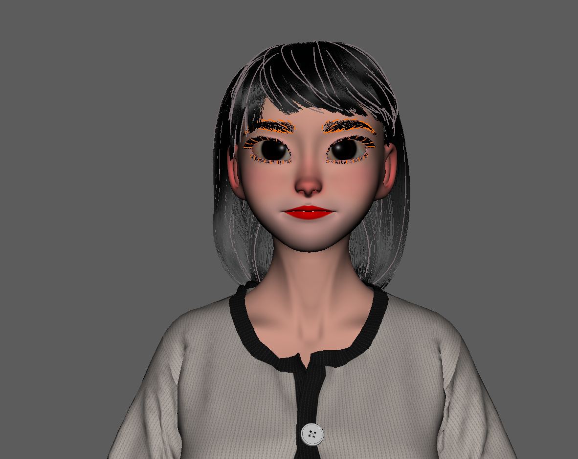
2 . 基于Mediapipe + Jax 的脸部驱动
目 录
1 . 数字虚拟偶像制作流程

Slide 3
Part 1 数字虚拟偶像制作流程

Slide 4
Digital Assets - Animation – Rendering
Full pipeline

Slide 5
Digital Assets
model – look development – cloth – hair

Slide 6
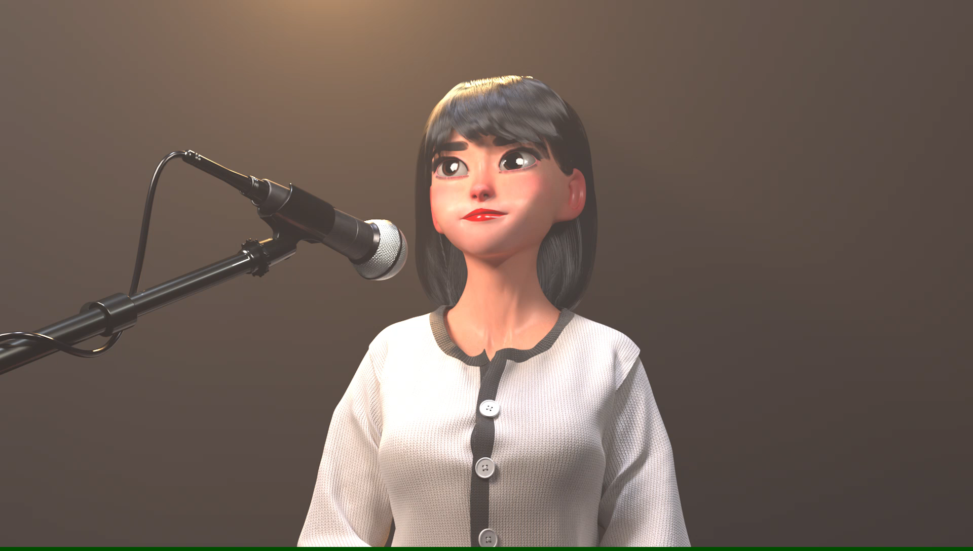
Digital Assets

Slide 7
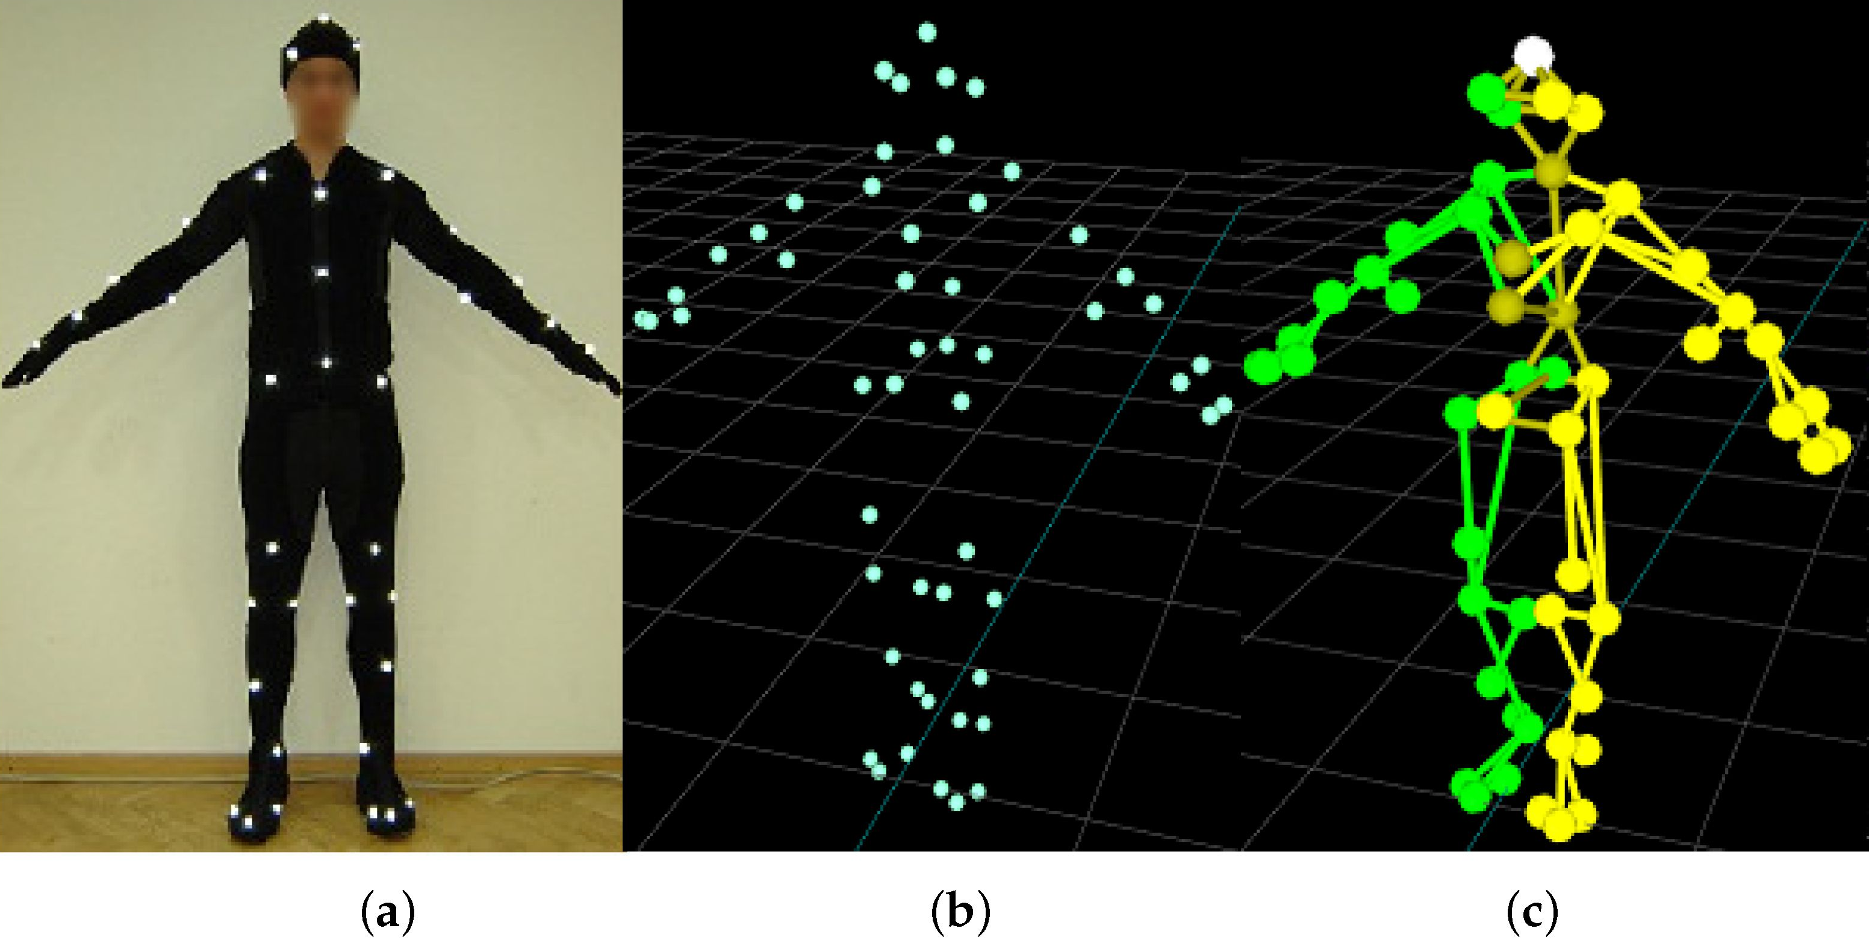
Animation
Body driving - Motion capture

Slide 8
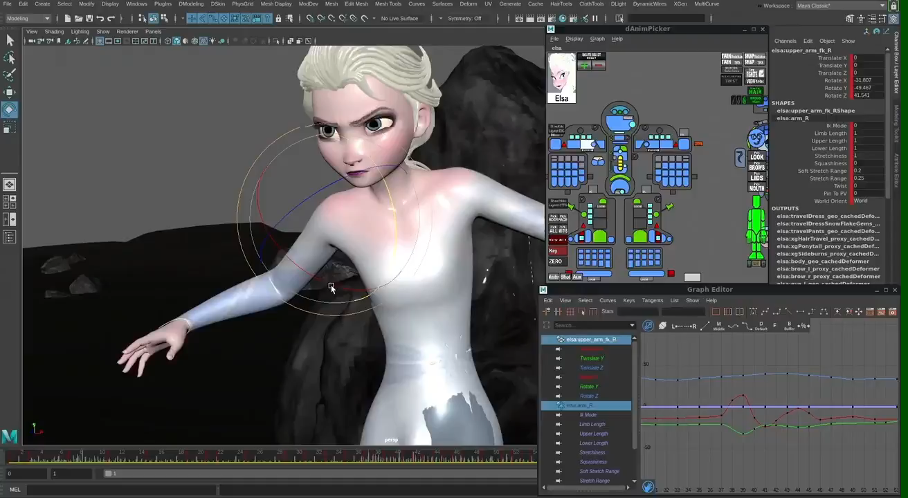
Animation
Body driving – Keyframe by hand

Slide 9
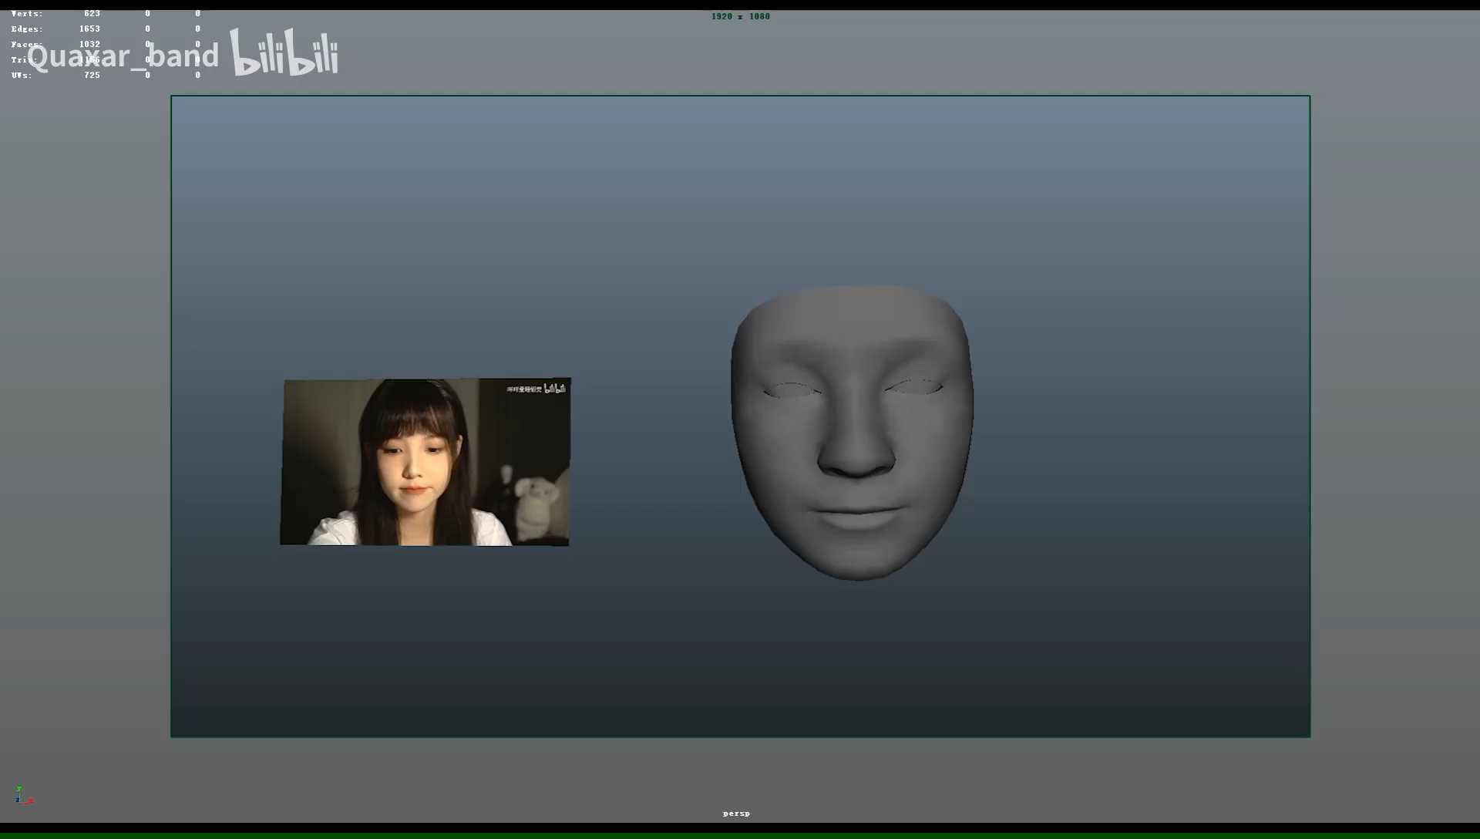
Animation
脸部驱动 - 基于脸部Landmark识别

Slide 10
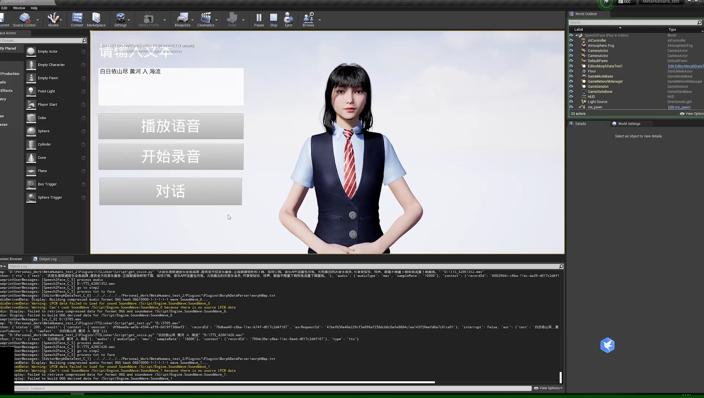
Animation
脸部驱动 - 基于自然语音识别驱动

Slide 11
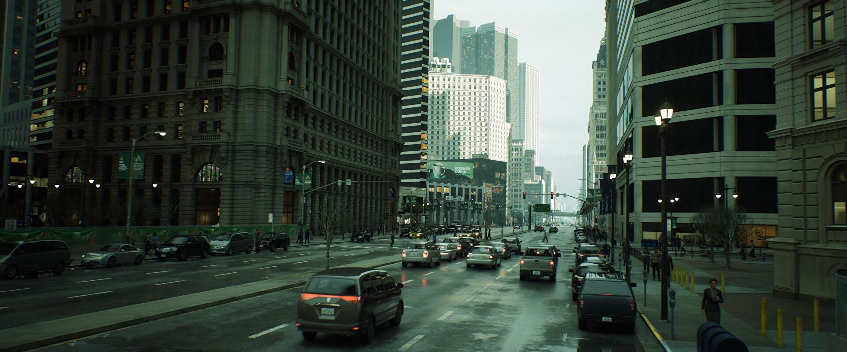
Rendering
Real-time rendering (usually based on gpu)

Slide 12
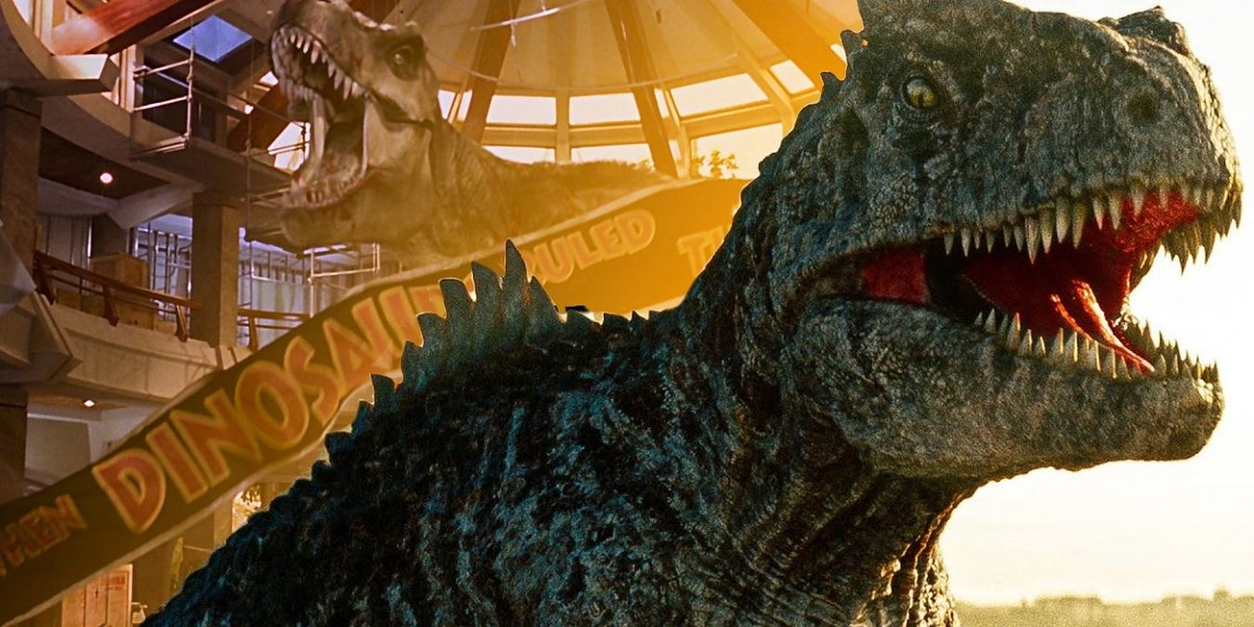
Rendering
Offline rendering (usually based on cpu)

Slide 13
Part 2 基于Mediapipe + Jax 的脸部驱动

Slide 14
机器学习项目一般步骤
1
2
3
4
5
数据处理
特征工程
模型设计
评估与优化
部署

Slide 15
从一个简单的线性回归例子开始：
Blink
Repo: https://github.com/benject/mediapipe_jax.git
1
2
3
4
5
数据处理
特征工程
模型设计
评估与优化
部署
（ mediapipe ）
（jax）

Slide 16
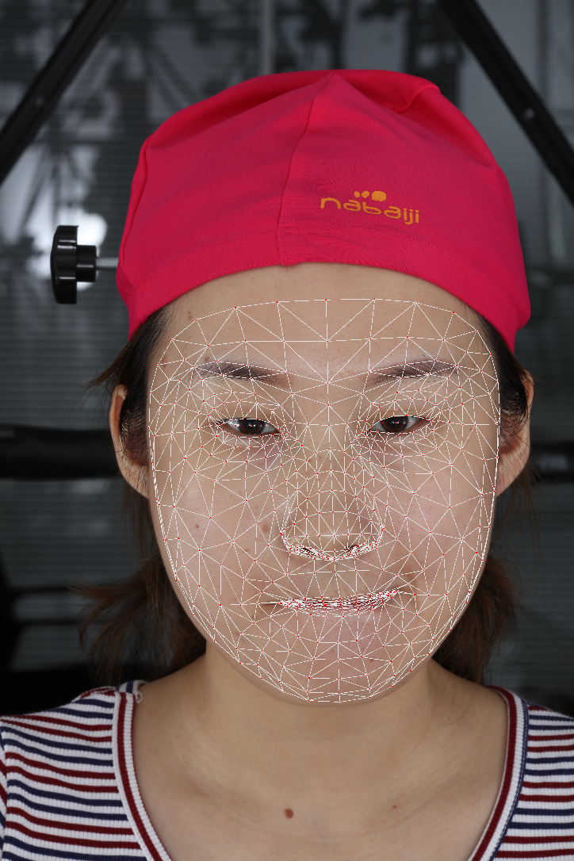
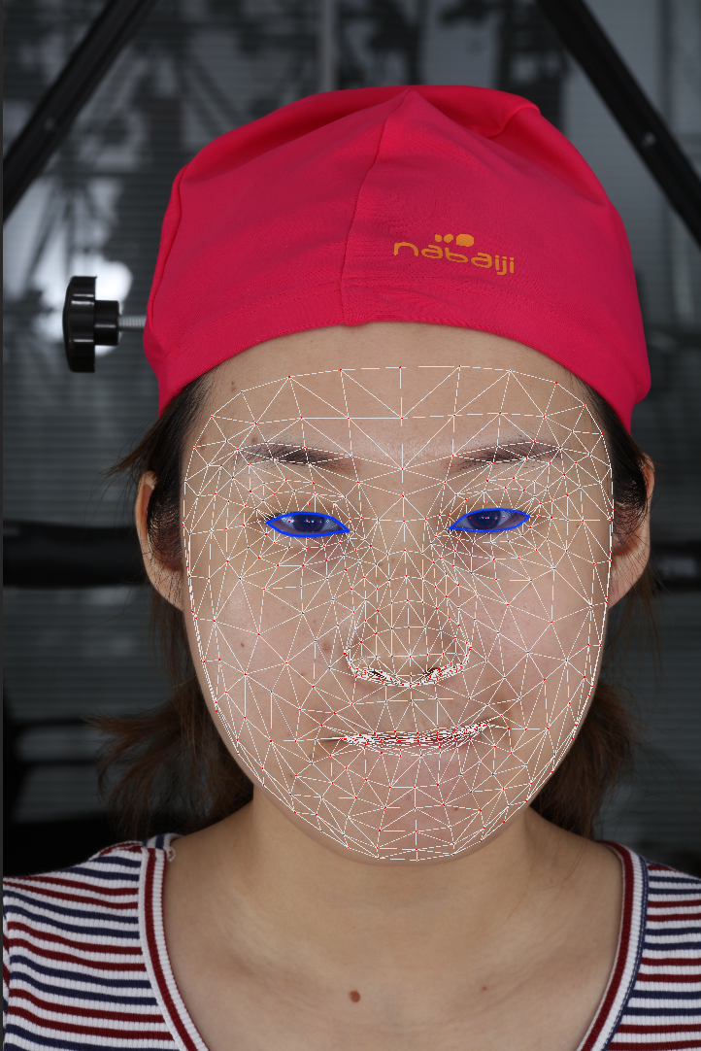
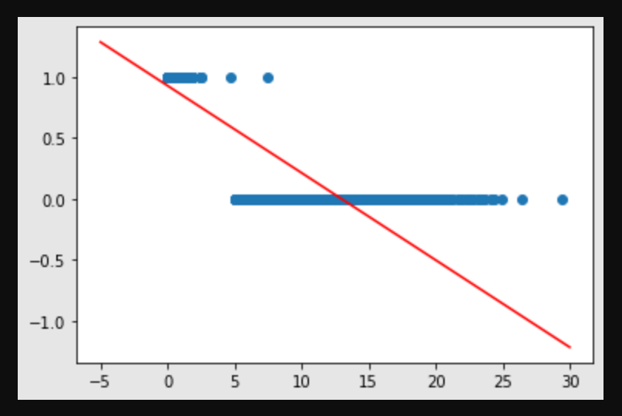
Blink
（ mediapipe ）
（jax）
Get facial landmarks
Compute area of eyes
Design a model to get the parameters

Slide 17
Dataset
数据收集
1.公开的Dataset
2.爬虫
3.众包

Slide 18
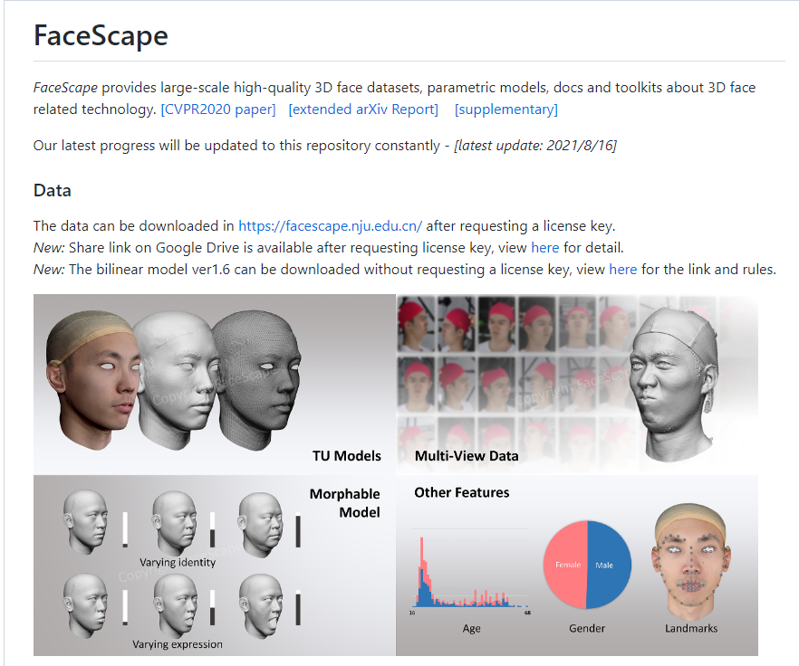
Dataset
Facescape[1]:
Large: >400k images
Multi-View Data: >50 views
High Quality: 4M – 12M pixels
[1]GitHub - zhuhao-nju/facescape: FaceScape: a Large-scale High Quality 3D Face Dataset and Detailed Riggable 3D Face Prediction (CVPR2020)

Slide 19
Dataset
Data cleaning
1.数据的规范
（resolution，format）
2. 数据的内容
（无效的数据，重复的数据，错误的标签，数据的噪声）

Slide 20
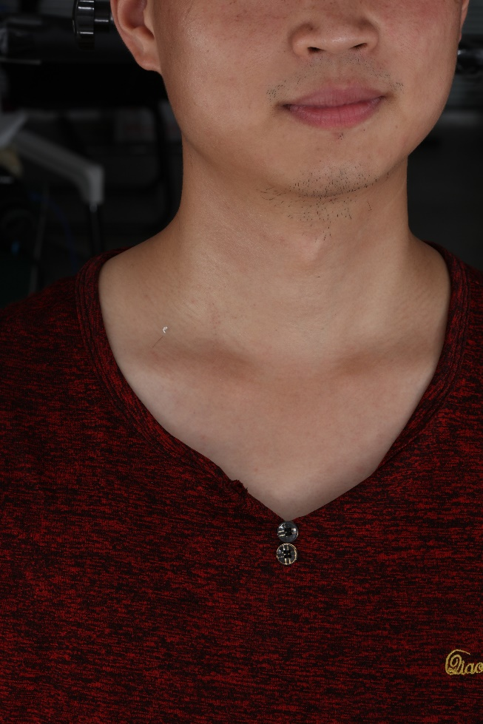
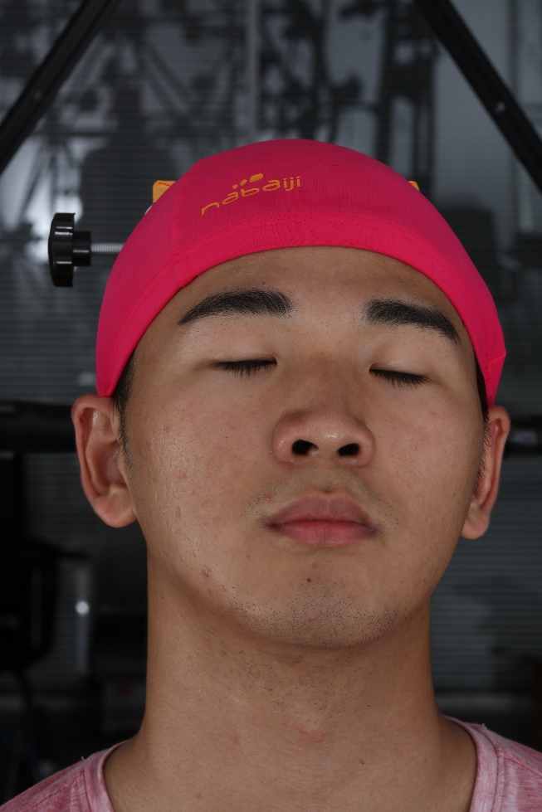
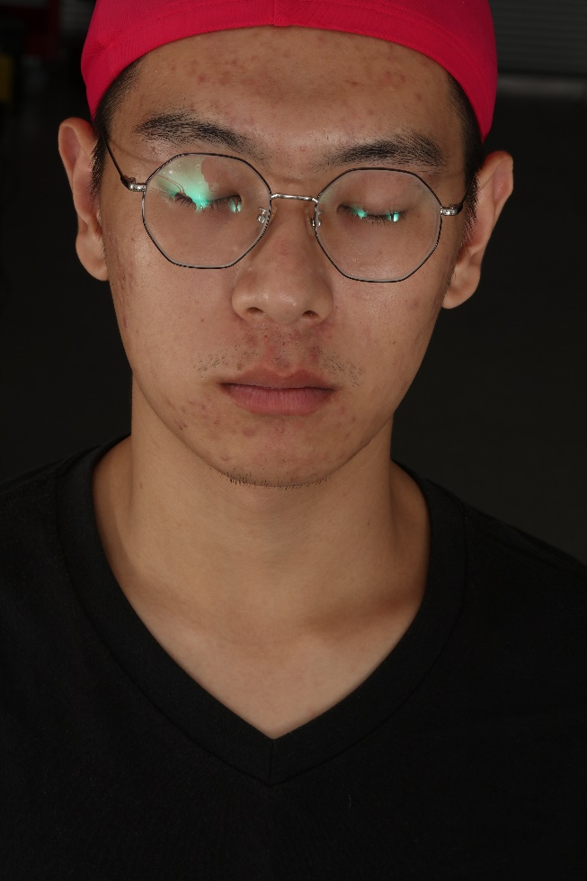
Wrong data
无效的数据（脸部被遮挡）
错误的标签（平静/闭眼）
数据的噪声（干扰特征点识别）

Slide 21
Feature engineering
From dataset to featureset
Features by hand（based on priori knowledge ）
End to End（auto feature extract）

Slide 22
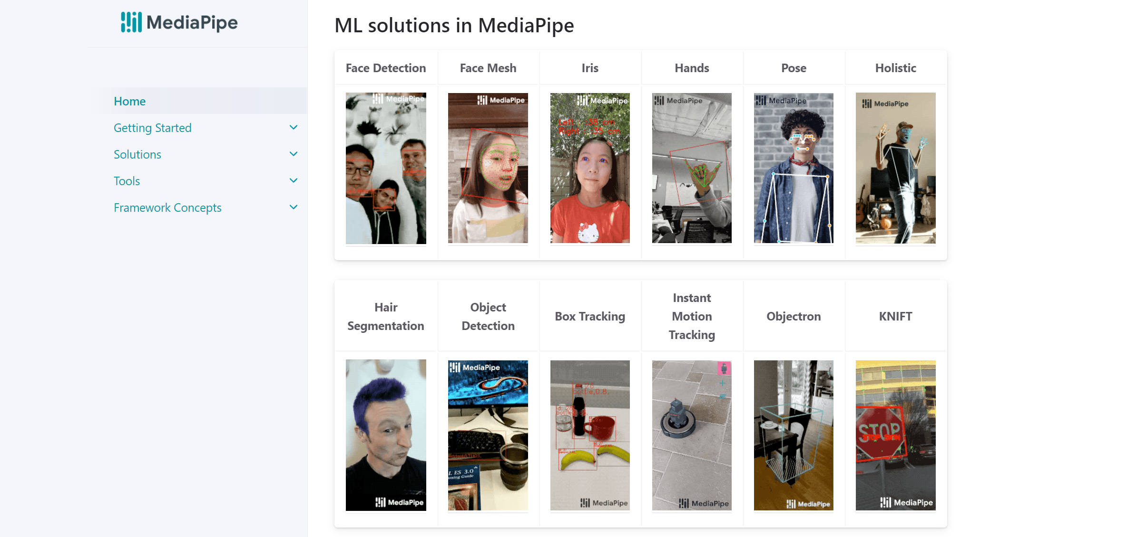
Mediapipe
Intro
MediaPipe offers cross-platform, customizable ML solutions for live and streaming media.[1]
[1] https://google.github.io/mediapipe/

Slide 23
Mediapipe
Facemesh
468 landmarks
Lightweight
High speed

Slide 24
Mediapipe
Coding time
#gen the dataset
mediapipe_jax/gen_dataset.py at main · benject/mediapipe_jax (github.com)
#gen the featureset
mediapipe_jax/gen_featureset.py at main · benject/mediapipe_jax (github.com)

Slide 25
Model Design
Linear Regression
Feature:
Area of eyes
Label:
Eye open ：Area > 0
Eye closed ： Area = 0
Parameters:
(w,b)
Y = wX + b
Find (w,b) which fit the data best.

Slide 26

JAX
JAX is Autograd and XLA, brought together for high-performance numerical computing and machine learning research.
It provides composable transformations of Python+NumPy programs: differentiate, vectorize, parallelize, Just-In-Time compile to GPU/TPU, and more.[1]
[1] https://jax.readthedocs.io/en/latest/

Slide 27
JAX
jax.numpy a high performance computing library
jax.grad for auto difference
jax.vmap for vectorization
jax.jit just in time compilation

Slide 28
JAX
Coding Time
#pytorch implementation
https://colab.research.google.com/github/benject/mediapipe_jax/blob/main/src/mirror/jax_linear_regression.ipynb
#jax implementation
https://colab.research.google.com/github/benject/mediapipe_jax/blob/main/src/mirror/jax_linear_regression.ipynb

Slide 29
模型评估
Tensorboard

Slide 30
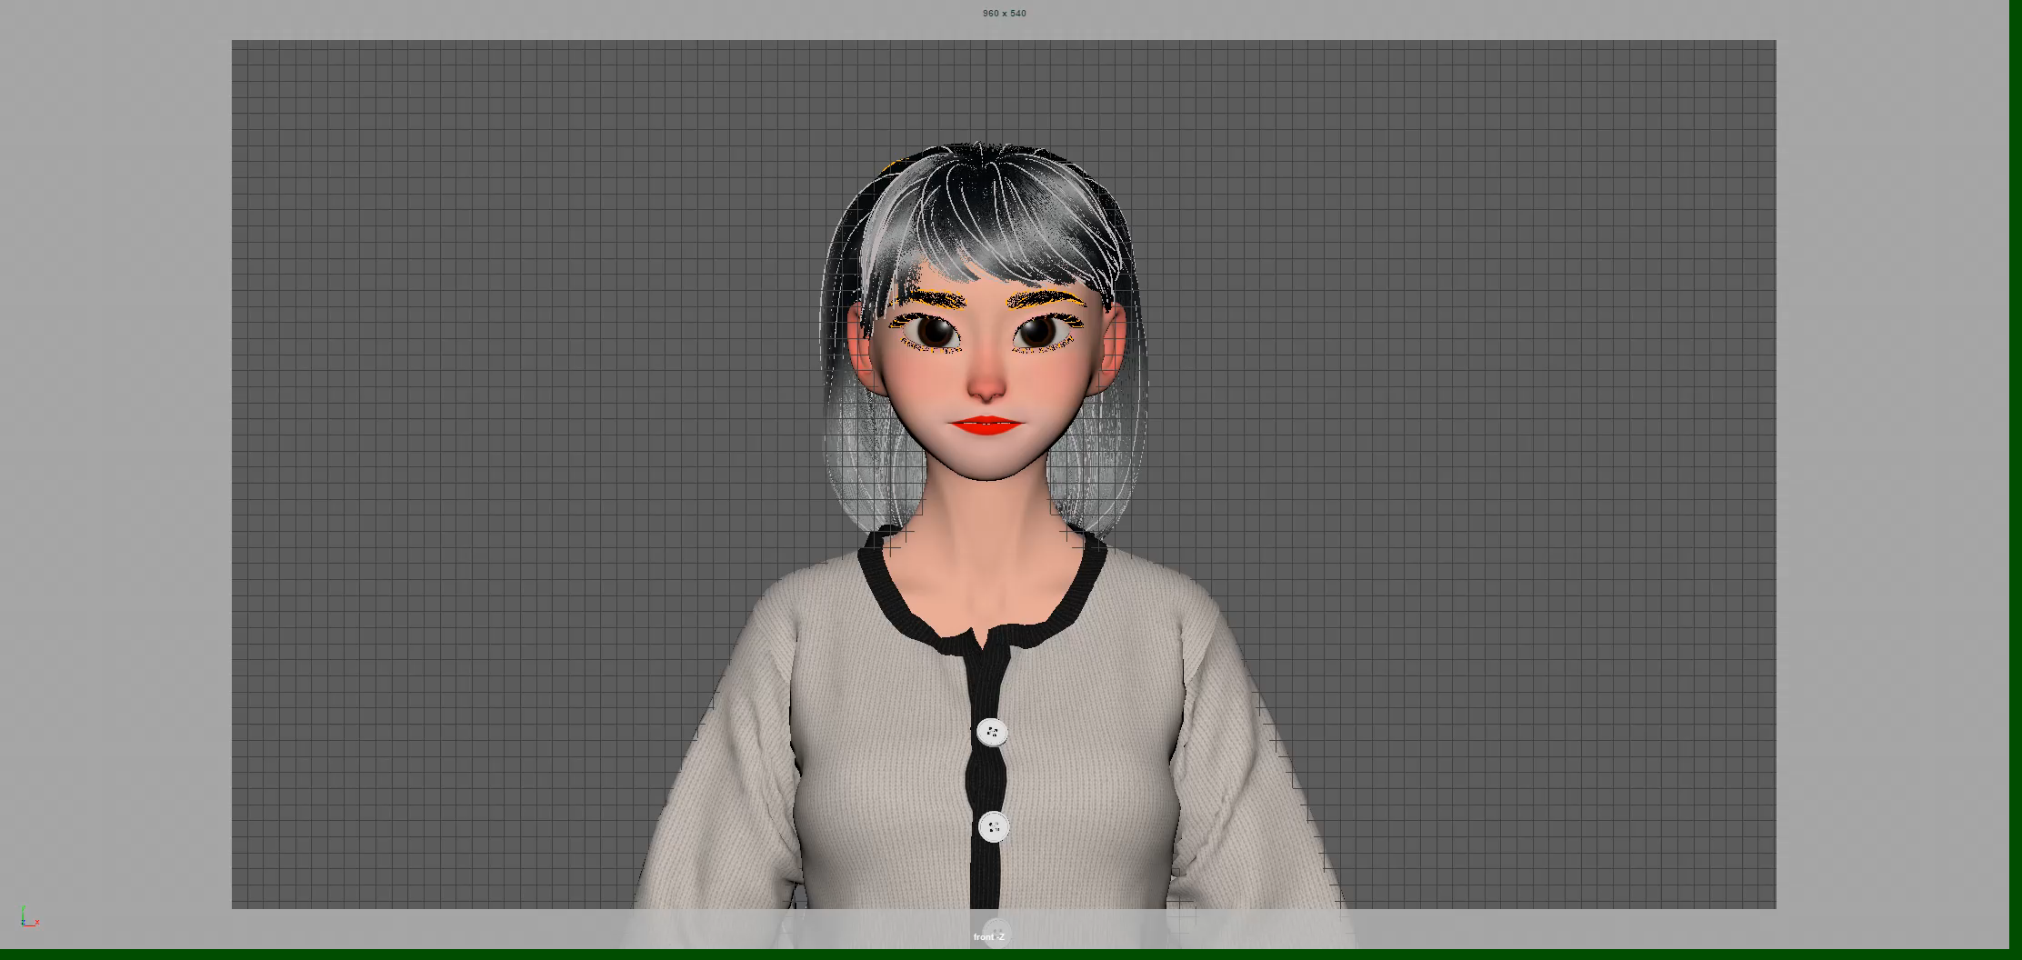
Deploy
Blendshapes : Final Model = Standard Model + Vertices Movement

Slide 31
Deploy
Input a image -> get the landmarks -> get the area of eyes -> predict the result -> set the blendshape value

